Slide 1
EFFICIENT INTEGER FACTORIZATION USING QUANTUM COMPUTERS
Shor’s Algorithm

Slide 2
Efficient Quantum Algorithm for Integer Factorization
FACTORING is reduced to finding a nontrivial square root of 1 modulo N.
Finding such a root is reduced to computing the order of a random integer modulo N.
The order of an integer is precisely the period of a particular periodic superposition.
Finally, periods of superpositions can be efficiently found by the quantum FFT.

Slide 3
STEP #1
FACTORING and nontrivial square root of 1 modulo N.

Slide 4

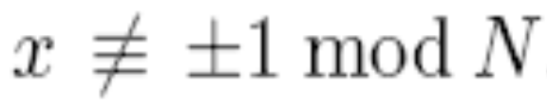
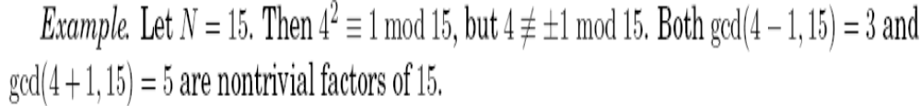
Therefore N must have a nontrivial factor in common with each of (x + 1) and (x - 1).

Slide 5
STEP #2
Reducing nontrivial square root of 1 to computing the order modulo N.

Slide 6
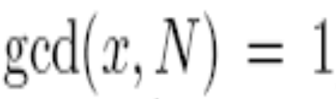
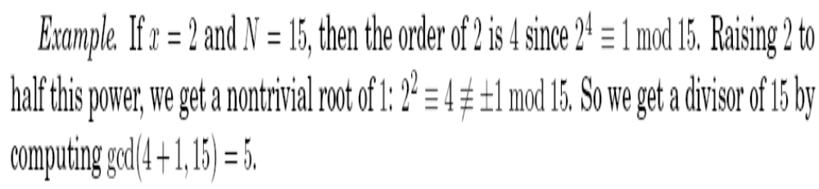
Order(x)
Choose a random x. Assume
If r, the order of x, is even then a nontrivial square root of 1 is:

Slide 7
STEP #3
The order of an integer is precisely the period of a particular periodic superposition.

Slide 8
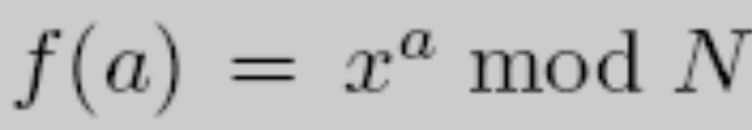
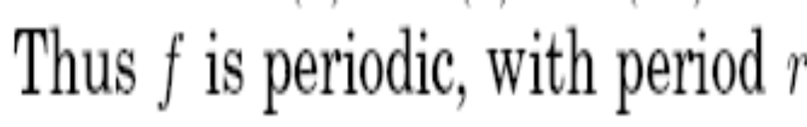

Slide 9
STEP #3 (Contd.)
Setting up the periodic superposition.

Slide 10
Quantum Mechanics
A quick introduction

Slide 11

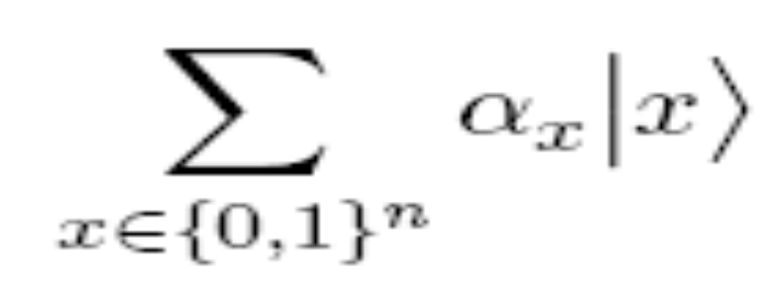
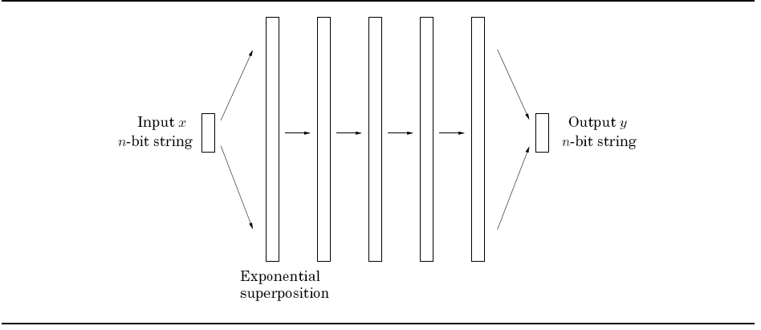
MASSIVE PARALLELISM
n Qubits =
The middle steps are all simple unitary transformations

Slide 12
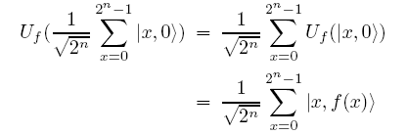
Quantum Parallelism
By linearity:

Slide 13
STEP #3 (Contd.)
Setting up the periodic superposition.

Slide 14

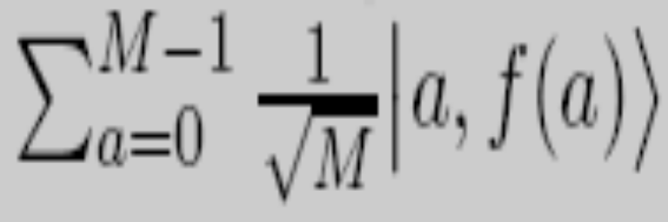
Setting Up the Periodic Superposition
Compute with U_{f} where:
Measure the second register. This gives a periodic superposition on the first register, with period r, the period of f.

Slide 15
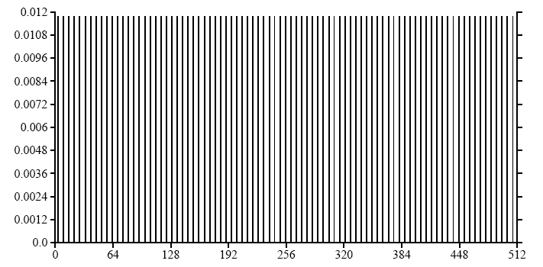
Example
X = {x| 11^{x} mod 21 = 8}
The state after this measurement clearly shows the periodicity of f

Slide 16
STEP #4
Quantum Fourier Transform (QFT)

Slide 17


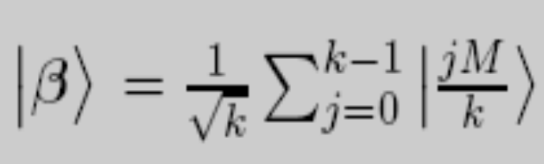
Fourier Transform of a Periodic Vector

Slide 18

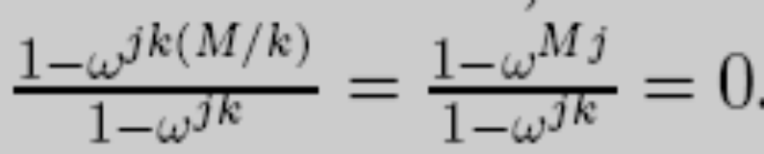
PROOF
If the ratio isn't 1:

Slide 19
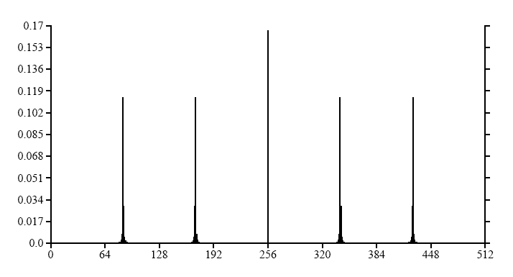
Example
Probability distribution of the quantum state after Fourier Transformation

Slide 20
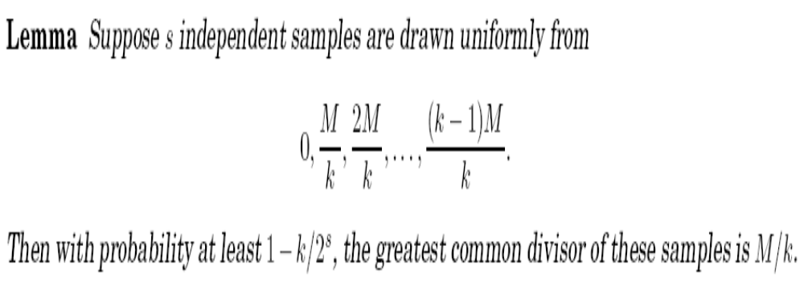
FINDING THE PERIOD VIA FOURIER TRANSFORM

Slide 21
EFFICIENT QFT

Slide 22
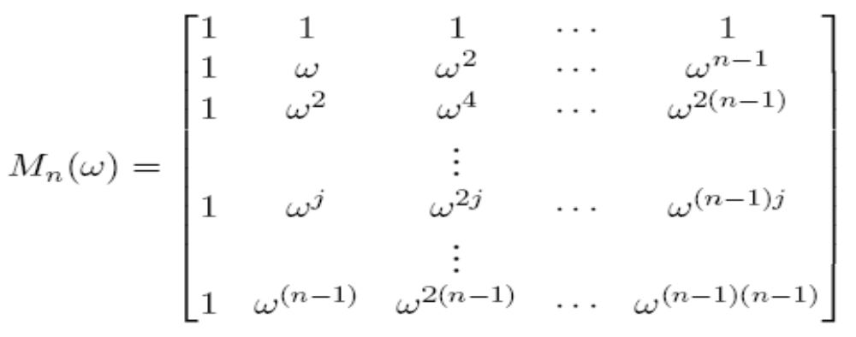

The FFT/DFT MATRIX

Slide 23
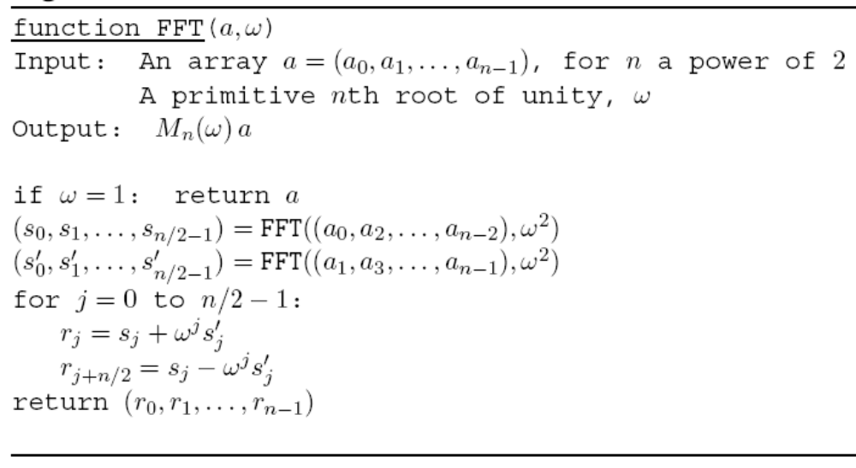
FFT ALGORITHM

Slide 24
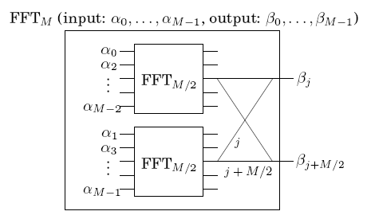
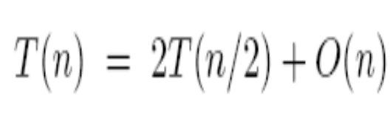
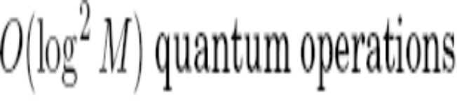
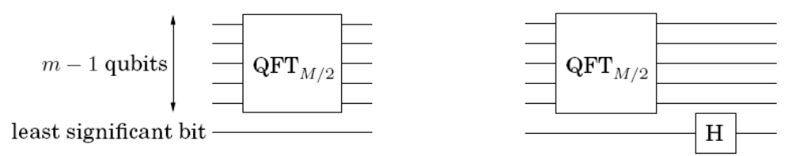
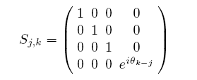
FFT Versus QFT
QFT =

Slide 25
SUMMARY
Putting it all together

Slide 26
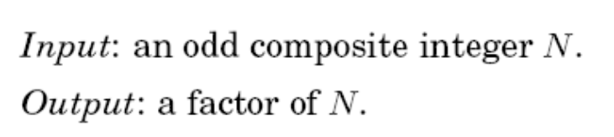
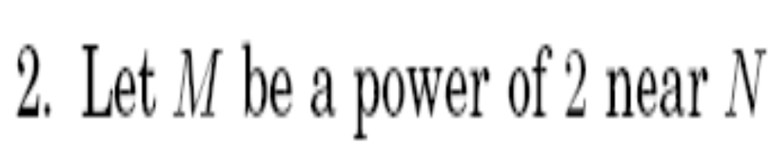
THE COMPLETE CODE

Slide 27

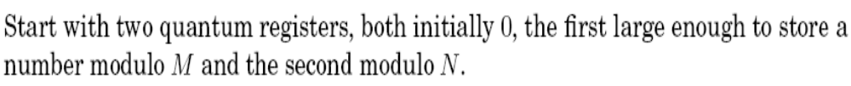
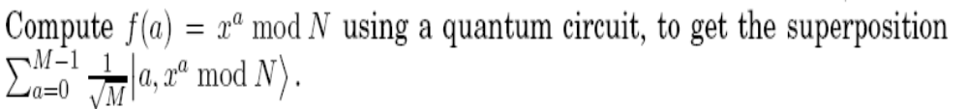

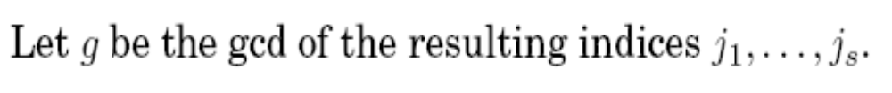
CODE (Contd.)

Slide 28
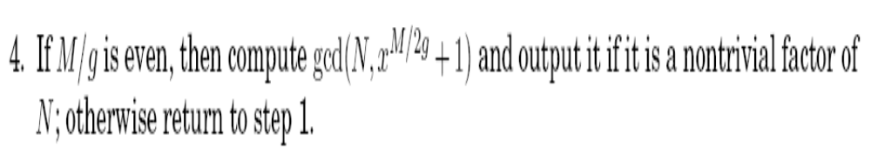
CODE (final step)

Slide 29
THANK YOU
Any Questions?

